Slide 1
Promises
By : Keshab basnet

Slide 2
What is promises ?
A promise is an object that will produce a single value sometime in the future.
if the promise is successful,it will produce a resolved value
If something goes wrong then it will produce a reason why the promise is failed

Slide 3
State of promises:
Pending : This is the default state of defined promises.
Fulfilled : This is the state of successful promises.
Rejected : This is the state of failed promises.

Slide 4
How to define promises :
new promise()
The promise constructor function takes one parameter. That parameter is a function that define when to solve the new promise and optionally when to reject it.
new promise(function(resolve , reject )
{
//code
)};

Slide 5
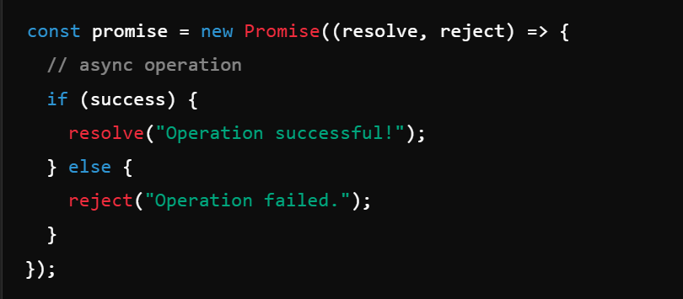
Basic syntax

Slide 6


